Slide 1




The Menstrual cycle - how it impacts on training and performance
Vanessa Davies & Dr Natalie Brown

Slide 2

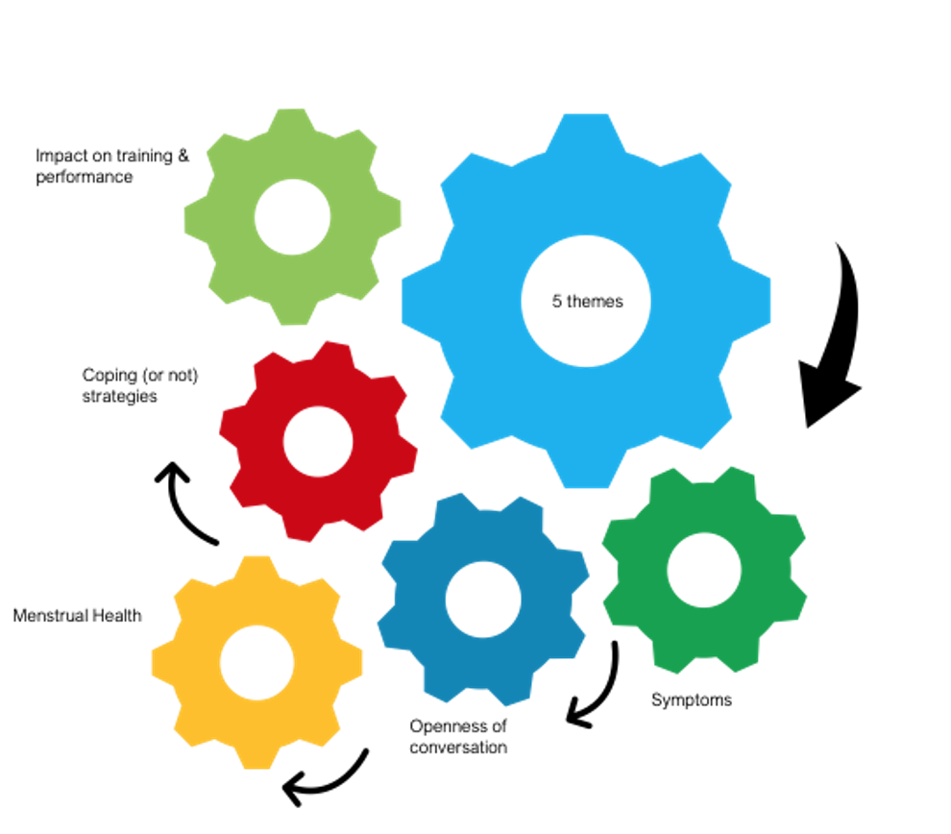
Female athlete – menstrual cycle

Slide 3
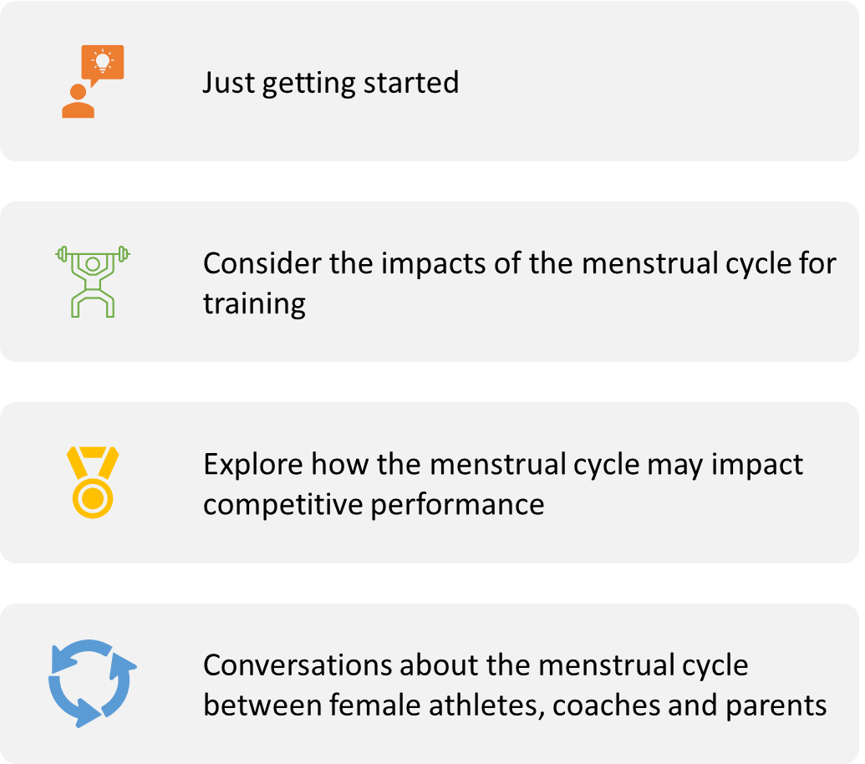
Aims

Slide 4
Menstrual health & performance
Health4Performance.co.uk
Notes:
Last week finished here...just to recap – energy deficiency, referred to as relative energy deficiency in sport (RED-S) can influence athlete health but also performance. Today we are going to focus on the performance aspect, not just from an energy deficiency perspective but also an athlete experiencing a normal cycle – how does that influence performance. At this point I think it is important to highlight the lack of research into female athletes and sport performance, with some contradicting findings, but provide some examples of female athletes whose performance has been affected by their menstrual cycle

Slide 5
Bobby Clay – RED-S
20 years old & never had a period
Struggles with osteoporosis
‘The girl who over trained’
‘The girl who under fuelled’
‘It won’t happen to me’

Slide 6
Bobby Clay – Her story
Age 15 in GB Team, competed at 1st World Cross Country Championships
Reached every target in training with ease
She moved training groups training was more intense
She began under fuelling
Body was forced into over training
Still meeting all training targets
She viewed having no periods as an athletics advantage
Parents took her to GP blood tests showed low levels of hormones but told it was fine and she was just a late developer
Broke her foot while swimming
Diagnosed with osteoporosis
Over the last year she has been fracture-free for 4 weeks!!
Notes:
I wanted to do more
Coach disagreed and didn't want her to push training so changed groups
Because sessions were more intense she was fuelling properly
Mention Jess Piasecki – contraceptive pill masked symptoms – didn’t have a natural cycle until 27

Slide 7
Menstrual cycle and performance
Progesterone increases catabolism
Sleep latency is altered affecting readiness and recovery
Learning, processing and spatial awareness are influenced
PMS influenced by inflammation affecting recovery
Recovery is altered at different stages of the cycle
Oestrogen interact with connective tissues affecting biomechanics and injury risk
Notes:
How can these impact on performance – talk about this!

Slide 8
Menstrual cycle and performance
Period:
Blood loss
Stomach cramps
GI disturbance
Late luteal phase:
Hormones declining can cause a broad range of physical and emotional symptoms
PMS increased by stress and inflammation
Headaches and fatigue are common
Increased risk illness URTI
Late follicular phase when Oestrogen is increasing:
‘Feel good’ hormone, increased energy & motivation to train
Better recovery – reduced duration DOMS
Helps muscles use glucose – favours high intensity exercise
Increased risk of injury
Decreased risk of illness
Mid Luteal phase when progesterone is increasing:​
Preferential use of fat as fuel = better endurance capabilities​
Slow digestion – constipation and bloating​
Poorer coordination​
Less risk taking​
Increased body temperature
Every individual is different and experiences different symptoms relating to the menstrual cycle

Slide 9
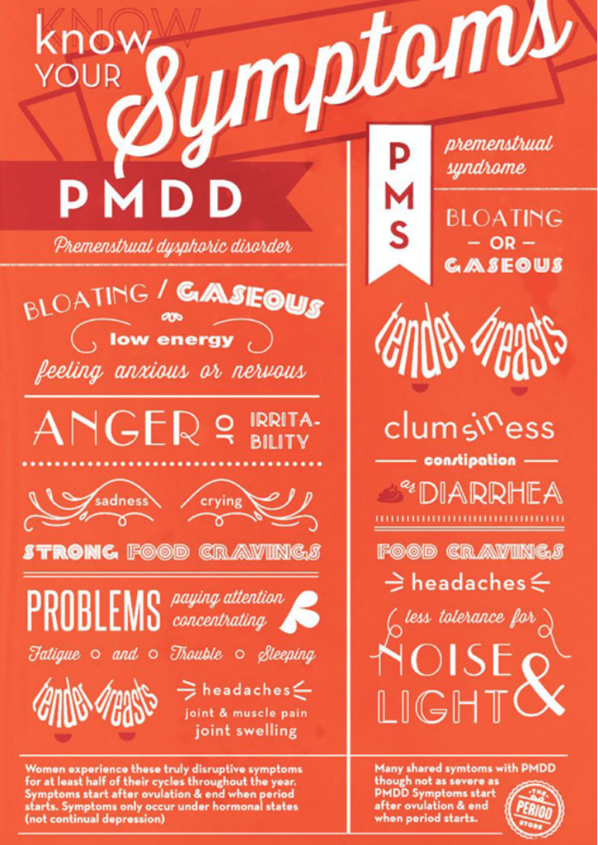
Welsh female athletes reported!!
Pain/cramps
Flooding/Heavy bleeding
Bloating
Sick/nauseous
Decreased energy/lethargic
Uncoordinated
Bad skin
Fainting
Lower back pain
Reduced recovery rate
Clumsiness
Weight gain
Sleep disturbance
Poor temp regulation
Tiredness
Change in breast size
Ill/cold symptoms
Headache
Dizziness
Gastrointestinal disturbance
Poor core control
Worry
Anxiety
Distracted
Emotional
Moody
Agitated
Restless
Reduced motivation
Irritable
Everyone is individual!
Notes:
How can these impact on performance – talk about this!

Slide 10
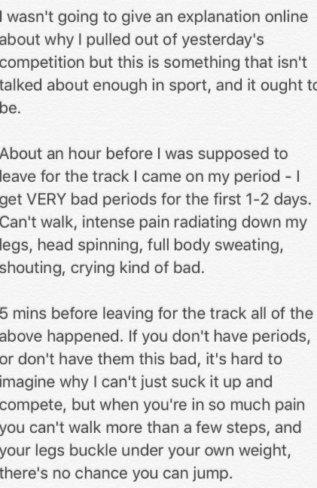
SUBTITLE
Jasmin Sawyer: ‘period pain forced me to pull out of Boston long jump'
Body Copy

Slide 11
Impact of the menstrual cycle training and competition
The menstrual cycle can affect – brain function, cardiovascular, respiratory, metabolic, thermoregulation, aerobic, anaerobic capacity, strength, injury rate, illness.
66% of athletes report training is worse at some point in their menstrual cycle
Interviews with Welsh athletes – 71% experienced abdominal cramps causing adjustment or missed training!
Olympic medal-winning performances have taken place during all phases of the cycle
Considering the menstrual cycle for performance benefits - prevent injury, illness and missed days training
Notes:
Research is variable
66% athlete reported performance is worse reduced coordination, delayed reaction time, delayed recovery, pain, poor sleep…

Slide 12
Paula Radcliffe
Paula Radcliffe revealed she 1st broke the marathon world record in Chicago in 2002 while suffering period cramps in the last 3rd of the race

Slide 13
"especially snatch, if you’re bloated and snatch is in your hip crease and you smack yourself with the bar, it’s such an uncomfortable thing"
"it has an effect on core strength, can’t hold myself in and being able to use core tension to move and sustain the movement to hold it properly"
"I’d rather eat chocolate and watch TV on the sofa"
"I found it had a lot of effect on motivation and energy levels, or just being happy enough to go and climb, because I’d be so worn down one week of the month I’d just be like, ‘I can’t do anything’ so I just wouldn’t train"
"time before my period impacts training and performance, once I’m on [menses] its just the inconvenience of bleeding”
“out of action”, “feel rubbish” and “sluggish during training”
Quotes from athletes
“it’s annoying for performance, more like core performance and impact of bloating”
"my periods were definitely worse when I was a teenager"
"first day is always pretty grim, I just feel terrible"
"If I’m feeling rotten or low on motivation, I’ll cut the session and move training to another day, instead I will do something active but not very energy requiring. It’s all of the powerful stuff that I’ll reduce down as I’m not as strong at that time because I’m not feeling it"
"feel a bit lousy, once it comes its absolutely fine"
"I think my cramps are a bit worse but I don’t get the headaches any more, that is why I came off the pill because of the headaches, well side effects really"
"So you are always like ‘oh my god have I leaked’ so the paranoia of leaking is horrible and distracts you, it’s another thing to manage"
"it’s annoying and inconvenient” whilst a weightlifter shared, “silently suffering, deal with it…it’s no one else’s problem, manage it anyway”

Slide 14
Consideration of youth athletes
As a junior athlete I had regular periods throughout. Started at 13.
One experience I remember as an U20 athlete I had my period the night before and due to bad period pain I had no sleep.
Subsequently the next day when I raced over 800m I had a really poor race and under performed massively compared to my potential.
This created a huge dent to my confidence and being honest I was unable to move on from this. I was 18 and I felt I let a lot of people down. Subsequently I had one more year in the sport and I then I stopped competing for about 10 years
Notes:
During the adolescent spurt, female athletes will undergo sex-specific physiological processes that may affect performance: increased fat mass, differential rates of development of neuromuscular strength, and height and weight; commencement of menstrual cycle, increased joint laxity, increased knee valgus angle; and increased reliance on quadriceps-dominant landing strategies, all of which have been associated with an increased risk of noncontact anterior cruciate ligament injury (^{2,43,51,52,72,75,86,89}).

Slide 15

Management strategies
‘Helping female athlete perform at their best on any day of their cycle’
Healthy, balanced diet – lots of fruit and veg, avoiding processed foods
Managing training and life stress
Sleep/recovery
Monitoring/tracking cycles to help understand and plan – self awareness
Period pain: Light exercise e.g. yoga, heat e.g. hot water bottle
Breast tenderness – correct fitting sports Bra
"I started [monitoring] after I stopped taking the pill because I didn’t know if I was regular or know when I’m supposed to be on with weightlifting, it was really helpful to know if I am going to be on [menses] before a competition and stop freaking out about weight as I can look back and be like ‘oh that’s okay it was the same last month and the month before"

Slide 16
Conversations are key!
By bringing menstruation out into the open, you’re letting others know that it’s okay to discuss.
Properly naming and talking about menstruation (without using euphemisms). It can be awkward at first, but the more you do it, the more comfortable you’ll be
Know your athlete and your athlete to have self-awareness. The link, having conversations to share observations and experiences to manage training and performance

Slide 17
"It’s crazy because we’ve had loads of workshops about diet and nutrition and like psychology and S&C and stretching and meetings with physios but something that happens every month that you can’t control, there’s nothing"
"if it was affecting me, I felt like it was affecting my performance, I would openly talk about it"
Quotes from athletes
"God no! No! I don’t think I would ever have had that conversation"
“…if they’re really awkward then it makes you feel more awkward”, and “you don’t want to make them feel uncomfortable"
"it’s not something you really want to tell your coach, look I’m on my period today…I don’t know, it’s something about telling your male coach I’m on my period that you don’t really if you cannot tell as many people as possible you try not to don’t you"
Notes:
Older athletes talking to younger athletes about menstrual cycle
Coaches teaching coaches
Young athletes just starting period 'coach info' around this – needs to be practical
Trust and comfort – build a relationship, understand what motivates them, personalities, in and out of sport

Slide 18
How to start the conversation?
Clarity – Clear message, sharing an observation
Evidence - share facts and knowledge
Effect – share the here and the now and what could be
Support – what next…
LISTEN – to the athlete experience, how could you action outcomes of the conversation?
3 barriers preventing conversations: confidence, knowledge, time
Notes:
3 barriers preventing conversations: confidence, skill, time
Clarity, clear message, what do we want to talk about, are we clear about what we have observed
Share your knowledge, think about the tone, environment, bigger picture, are you the best person? How to start the conversation – maybe not ‘how’s it going’
What effect is this having at present, what about long term? Consider their feelings. Don’t simplify or over complicate
Listen to the athlete’s and how this could contribute towards training otherwise conversation will feel wasted and not acknowledged e.g Female athlete informs there are 2 days a month she feels less powerful, reduced motivation and becomes frustrated in training, ignoring this will not support the individual or athlete – how could you adjust training for those 2 days to increase performance?
Collaborate to help support, find a solution, who needs to be involved?
Reflect!!

Slide 19

Approaching an athlete - difficult conversations
  Try not to let your own feelings of frustration or worry dictate how and when you approach an athlete
  When is the best time – tired, hungry, experiencing mood swing??
  Who might be the best person to approach the athlete - it might not necessarily be you.
  No right way – no 2 conversations will be the same and adapt approach
  Early intervention - don’t ignore the problem, important for long health and performance of the athlete.
  Engage and support conversations without causing or displaying feelings of awkwardness
  Challenging BUT preferable to ignoring it!

Slide 20
Considerations
Change perceptions of awkwardness!
Avoid statements such as:
  ‘Don’t need to know any more detail’
  ‘OK that’s enough’
Trust and comfort – build a relationship and open communication
Support as an individual and an athlete – person centered approach
Prepare for:
Report feelings of topic 'off limits' because of personal nature
May not have a positive initial response – persistent, continue to raise issue
Denial – worry of disappointing or not able to train
Ideas:
Older athletes talking to younger athletes?
Coaches and parents supporting each other?
Notes:
Older athletes talking to younger athletes about menstrual cycle
Coaches teaching coaches
Young athletes just starting period 'coach info' around this – needs to be practical
Trust and comfort – build a relationship, understand what motivates them, personalities, in and out of sport

Slide 21
Action and thoughts
Think - 2 things learnt from part 1 and part 2
Consider:
How are you going to share this knowledge with coaches and parents you work with?
Write - 1 action to complete following these webinars on female athlete
How are you going to put this into practice or build on today?

Slide 22
Signposting and Questions
Vanessa Davies – vanessa.davies@sport.wales
Dr Natalie Brown – natalie.brown@sport.wales

